Slide 1


Chapter 7
IP Addressing Services
Part I

Slide 2
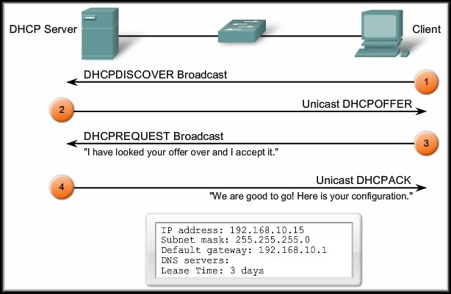
IP Addressing Services
Dynamic Host Configuration
Protocol (DHCP)

Slide 3
Dynamic Host Configuration Protocol (DHCP)
Every device that connects to a network needs an IP address.
  Network administrators assign static IP addresses to routers, servers, and other network devices whose locations (physical and logical) are not likely to change.
  User computers in an organization often change locations, physically and logically.
    Desktop clients do not require a static address.
    A workstation can use any address within a range of addresses.
    This range is typically within an IP subnet.

Slide 4


Dynamic Host Configuration Protocol (DHCP)
Administrators typically prefer a network server to offer DHCP services.
  Scalable.
  Relatively easy to manage.
In a small branch or SOHO location, a Cisco router can be configured to provide DHCP services without the need for an expensive dedicated server.

Slide 5
DHCP Operation
Address Allocation Methods:
  Manual:
    The IP address for the client is pre-allocated by the administrator and DHCP conveys the address to the client.
  Automatic:
    DHCP automatically assigns a permanent IP address to a client with no lease period.
  Dynamic:
    DHCP assigns, or leases, an IP address to the client for a limited period of time.

Slide 6

DHCP Operation
Dynamic Allocation:
  DHCP works in a client/server mode.
    When the client connects, the server assigns or leases an IP address to the device.
    The device connects to the network with that leased IP address until the lease period expires.
    The host must contact the DHCP server periodically to extend the lease.
    The leasing of addresses assures that addresses that are no longer used are returned to the address pool for use by other devices.

Slide 7
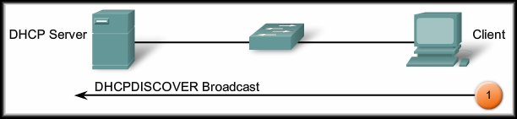
DHCP Operation
Dynamic Allocation: 4 Step Process.
  DHCPDISCOVER:
    The client broadcasts a DHCPDISCOVER message.
    The DHCPDISCOVER message finds the DHCP server(s) on the network.

Slide 8
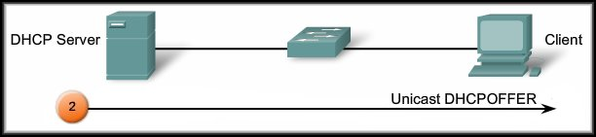
DHCP Operation
Dynamic Allocation: 4 Step Process.
  DHCPOFFER:
    The server responds with a DHCPOFFER.
    The DHCPOFFER message is sent as a unicast and contains an available IP address to lease.

Slide 9
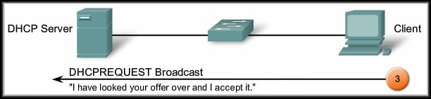
DHCP Operation
Dynamic Allocation: 4 Step Process.
  DHCPREQUEST:
    The client responds with a broadcast of a DHCPREQUEST message.
    When used for obtaining a lease, it serves as an acceptance notice to the selected server and an implicit decline to any other servers.
    Also used for lease renewal and verification.

Slide 10
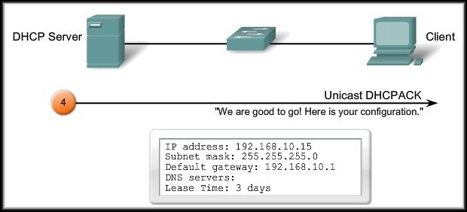
DHCP Operation
Dynamic Allocation: 4 Step Process.
  DHCPACK:
    The server verifies the lease information and responds with a DHCPACK message.
    The client logs the information and sends an ARP request to verify that the address is unique.

Slide 11
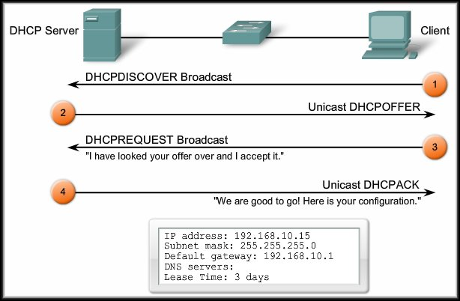
DHCP Operation
Dynamic Allocation: 4 Step Process.

Slide 12
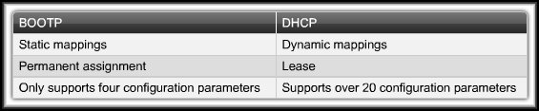
BOOTP and DHCP
Bootstrap Protocol (BOOTP):
  Predecessor of DHCP.
  A method to download address and boot configurations for diskless workstations.
  Both DHCP and BOOTP are client/server based and use UDP ports 67 and 68.
  The main difference is that BOOTP was designed for manual pre-configuration of the host information in a server database.

Slide 13
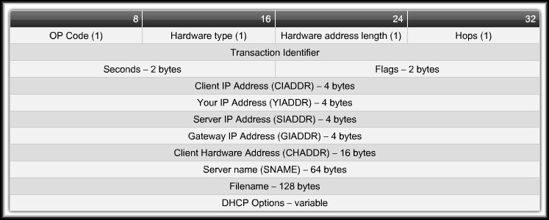
DHCP Message Format
The developers of DHCP needed to maintain compatibility with BOOTP.
Same as BOOTP
Added to support functions of DHCP.

Slide 14
Configuring a Cisco Router as a DHCP Server
3 Basic Steps:
  Step 1:
    Define a range of addresses that DHCP is not to allocate.
    Usually static addresses reserved for the router interface, switch management IP address, servers, and local network printers.
  Step 2:
    Create the DHCP pool of addresses using the
    ip dhcp pool command.
  Step 3:
    Configure the specific DHCP tasks for the pool.

Slide 15
Configuring a Cisco Router as a DHCP Server
The DHCP service is enabled by default on versions of Cisco IOS that support it.
  To disable the service:
  Router(config)#no service dhcp
  To enable the service:
  Router(config)#service dhcp

Slide 16
Configuring a Cisco Router as a DHCP Server
Step 1:
  Exclude an address or addresses from the pool:
Router(config)#ip dhcp excluded-address
low-address [high-address]
    Exclude an individual address or range of addresses when assigning addresses to clients.
    Used to reserve addresses that are statically assigned to key hosts, for instance, the interface address on the router.

Slide 17
Configuring a Cisco Router as a DHCP Server
Step 2:
  Create the DHCP pool and place the router in DHCP configuration mode.
Router(config)#ip dhcp pool [pool-name]
Router(config-dhcp)#

Slide 18
Configuring a Cisco Router as a DHCP Server
Step 3:
  Configure the specific DHCP tasks.
  Define the pool of addresses:
  Router(config-dhcp)#
  network network-number [mask | /prefix]
  The network statement enables DHCP on any router interfaces belonging to that network.
    The router will act as a DHCP server on that interface.
    It is also the pool of addresses that the DHCP server will use.

Slide 19
Configuring a Cisco Router as a DHCP Server
Step 3:
  Configure the specific DHCP tasks.
  Assign the default gateway for the DHCP clients:
Router(config-dhcp)#
default-router ip-address [ip-address2……]
  Only one is required but up to 8 addresses may be assigned in one command line.

Slide 20
Configuring a Cisco Router as a DHCP Server
Step 3:
  Configure the specific DHCP tasks.
  Assign the DNS Server(s) for the DHCP clients:
Router(config-dhcp)#
dns-server ip-address [ip-address2……]
    Only one is required but up to 8 addresses may be assigned in one command line.

Slide 21
Configuring a Cisco Router as a DHCP Server
Step 3:
  Configure the specific DHCP tasks.
  Assign the WINS Server(s) for the DHCP clients:
Router(config-dhcp)#
netbios-name-server ip-address
[ip-address2……]
    Only one is required but up to 8 addresses may be assigned in one command line.

Slide 22
Configuring a Cisco Router as a DHCP Server
Step 3:
  Configure the specific DHCP tasks.
  Assign the Domain Name for the DHCP clients:
Router(config-dhcp)#
domain-name [domain]

Slide 23
Configuring a Cisco Router as a DHCP Server
Step 3:
  Configure the specific DHCP tasks.
  Assign the duration of the lease for the DHCP clients:
Router(config-dhcp)#
lease {days [hours] [minutes] | infinite}
    The default lease time is 1 day.

Slide 24
Configuring a Cisco Router as a DHCP Server
Step 3:
  Configure the specific DHCP tasks.
  FYI - Other available parameters:
Router(config-dhcp)#
netbios-node-type [type]
host address [mask | /prefix]
hardware-address hardware-address-type
or client-identifier unique-identifier
client-name name
bootfile filename

Slide 25
Configuring a Cisco Router as a DHCP Server
FYI
  By default, the DHCP server pings a pool address twice before assigning the address to a requesting client.
  If the ping is unanswered within 500 ms (i.e. times out), the DHCP server assumes that the address is not in use and assigns the address to the requesting client.
  To change the number of ping packets sent and/or the timeout wait value:
Router(config)#ip dhcp ping packets number
Router(config)#ip dhcp ping timeout milliseconds

Slide 26
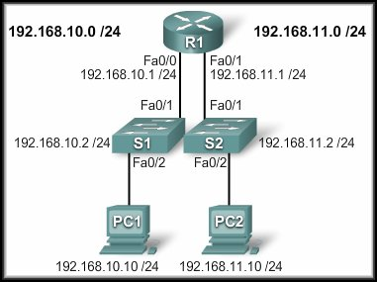
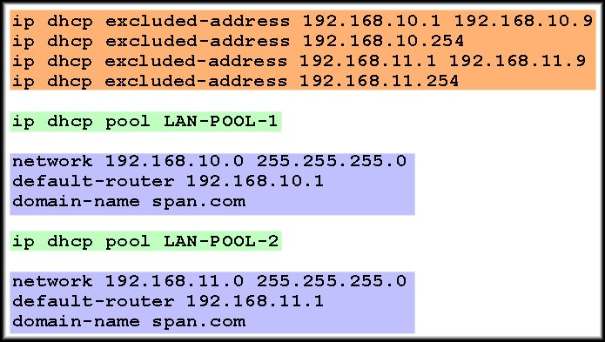
Configuring a Cisco Router as a DHCP Server
Step 1
Step 2
Step 3

Slide 27
Configuring a Cisco Router as a DHCP Server
Verifying DHCP:
Router#
show ip dhcp binding
show ip dhcp server statistics
show ip dhcp pool
debug ip dhcp server events
Much more detail in the lab….

Slide 28
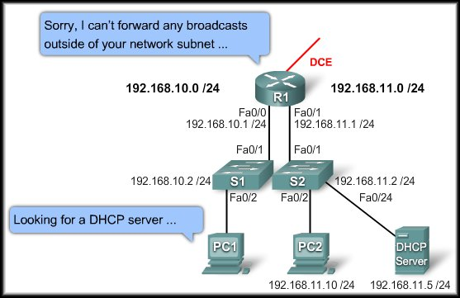
DHCP Relay
In a complex hierarchical network, enterprise servers are usually contained in a server farm.
These servers may provide DHCP, DNS, TFTP, and FTP services for the clients.

Slide 29
DHCP Relay
Broadcast
Broadcast
PC1 either tries to obtain an IP configuration or attempts to renew its address.
In addition, other network services use broadcasts to find a TFTP server or an authentication server.

Slide 30
DHCP Relay
Broadcast
Broadcast
The solution is DHCP Relay.
By configuring a helper address feature on intervening routers and switches the device will forward DHCP broadcasts, and others, to the appropriate server.

Slide 31
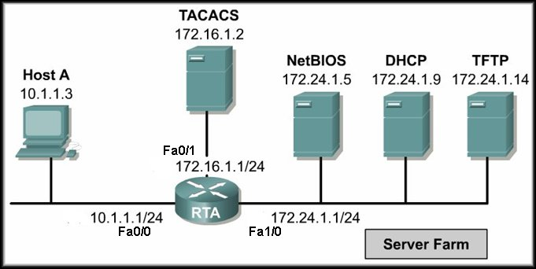
DHCP Relay
Broadcast
To configure RTA Fa0/0 (the interface that receives the Host A broadcasts) to relay DHCP broadcasts to the DHCP server, use the following commands:
RTA(config)#interface fa0/0
RTA(config-if)#ip helper-address 172.24.1.9

Slide 32
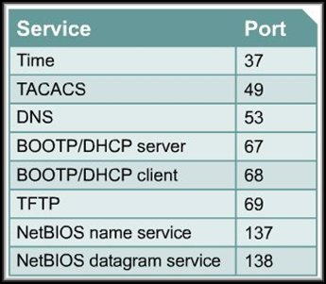
DHCP Relay
DHCP is not the only service that the router can be configured to relay.
By default, the
ip helper-address
command forwards
broadcasts for eight
UDP services.

Slide 33
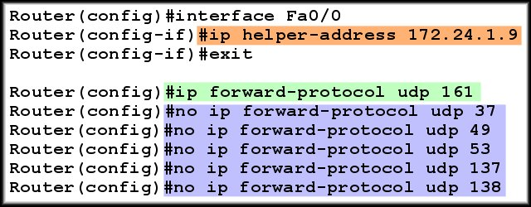
DHCP Relay
Default Forwarded UDP Services
If you wish to stop the forwarding of a service or add another service for forwarding, it can be done using the
ip forward-protocol command.
Add SNMP

Slide 34
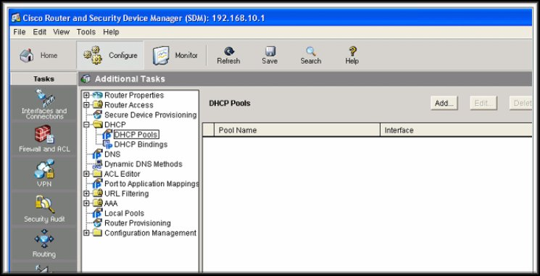
Configuring a DHCP Server Using SDM
DHCP can also be configured using the Cisco Router and Security Device manager (SDM).

Slide 35
Troubleshooting DHCP Configuration
Resolve any IP Address conflicts.
show ip address conflicts
Verify physical connectivity.
Test connectivity by configuring a workstation with a static IP address.
Verify switch port configuration.
Do DHCP clients obtain an IP address on the same subnet or VLAN where the DHCP server resides?
  Verify any DHCP Relay configuration.
Verify that the router is receiving DHCP requests.
debug ip dhcp events debug ip dhcp server
      debug ip packet detail

Slide 36
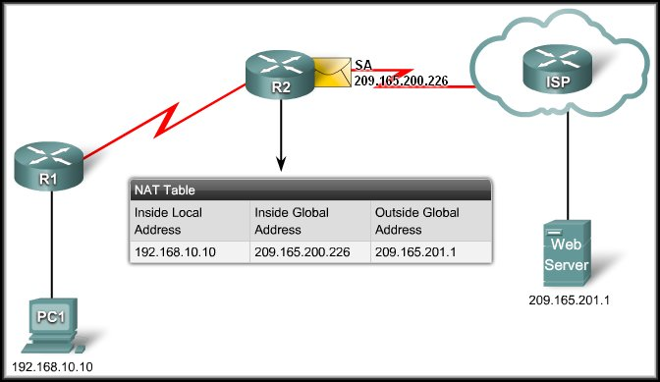
IP Addressing Services
Scaling Networks With Network Address Translation (NAT)

Slide 37
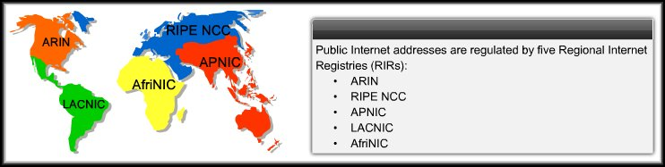
Scaling Networks With NAT
All public Internet addresses must be registered with a Regional Internet Registry (RIR).
Organizations can lease public addresses from an ISP.
Only the registered holder of a public Internet address can assign that address to a network device.

Slide 38
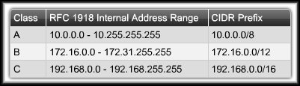
Scaling Networks With NAT
Private Internet Addresses:
  These are reserved private Internet addresses drawn from three blocks.
  These addresses are for private, internal network use only.
  RFC 1918 specifies that private addresses are not to be routed over the Internet.

Slide 39
Scaling Networks With NAT
Private Internet Addresses:
  Two Issues:
    You cannot route
    private addresses over the Internet.
    There are not enough public addresses to allow organizations to provide one to every one of their hosts.
  Networks need a mechanism to translate private addresses to public addresses at the edge of their network that works in both directions.
  Solution – NAT.

Slide 40
What is NAT?
The DHCP server assigns IP dynamic addresses to devices inside the network.
NAT-enabled routers retain one or many valid Internet IP addresses outside of the network.
When the client sends packets out of the network, NAT translates the internal IP address of the client to an external address.
To outside users, all traffic coming to and going from the network has the same IP address or is from the same pool of addresses.
NAT
Private Address
Public Address

Slide 41
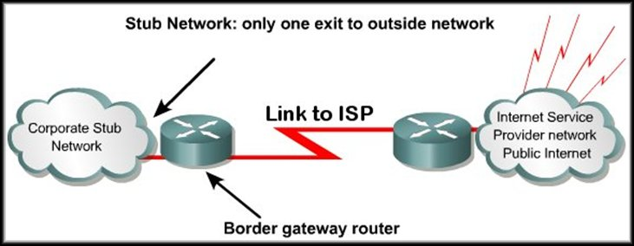
What is NAT?
A NAT enabled device typically operates at the border of a stub network.
A stub network is a network that has a single connection to its neighbor network.

Slide 42
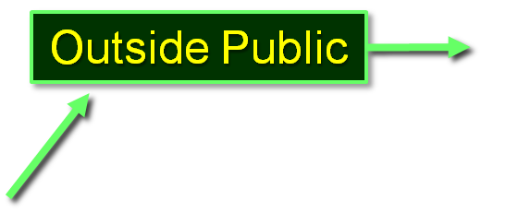
What is NAT?
Inside Private
When a host on the inside network wants to access a host on the outside network, the packet is sent to the border gateway router.
The border gateway router performs the NAT process, translating the inside private address to an outside public address.

Slide 43
What is NAT?
Inside Private
The translation process uses an internal translation table.
The contents of the table will vary depending on the type of network translation being implemented.
We will be looking at the use of static NAT, dynamic NAT and Port Address Translation (PAT).

Slide 44
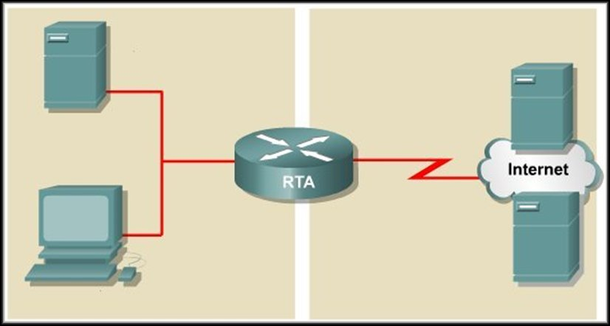
NAT Terminology
Inside Network:
Usually an organization’s LAN.
Outside Network:
Usually the Internet but it can be any network.

Slide 45


NAT Terminology
Local Addresses:
How a node on a network is seen by another node on
the same network.
128.23.2.2
10.0.0.2
10.0.0.3
128.23.3.3

Slide 46
NAT Terminology
Global Addresses:
How a node on one network
is seen by a node on another network.
128.23.2.2
10.0.0.2
10.0.0.3
128.23.3.3

Slide 47
NAT Terminology
Inside Local Address:
  An RFC 1918 address assigned to a host on an inside network.
Inside Global Address:
  A valid public address that the host on the inside network is assigned as it exits the router.
Outside Global Address:
  A reachable IP address assigned to a host on the Internet.
Outside Local Address:
  A local address assigned to a host on an outside network.
  (Use beyond the scope of this course).

Slide 48
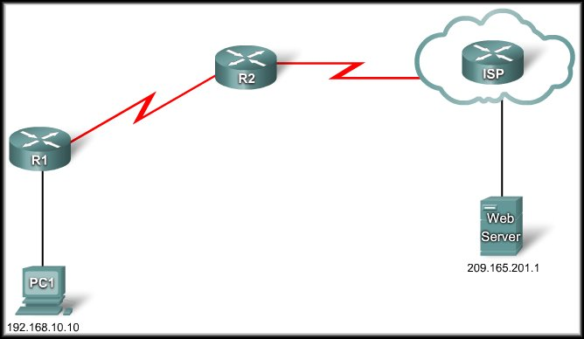
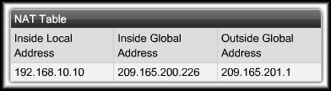
How Does NAT Work?
R2: I have a packet for the outside network.
I must translate the IP address.
Send
209.165.200.226
DA | SA
209.165.201.1 | 209.165.200.226
DA | SA
209.165.201.1 | 192.168.10.10

Slide 49
How Does NAT Work?
R2: I have a packet for the inside network.
I must translate the IP address.
Receive
DA | SA
192.168.10.10 | 209.165.201.1
209.165.200.226
DA | SA
209.165.200.226 | 209.165.201.1

Slide 50
Dynamic Mapping and Static Mapping
NAT Table
Inside Local | Inside Global
10.0.0.1 | 179.9.8.81
10.0.0.2
10.0.0.3
10.0.0.4
10.0.0.5
10.0.0.6
10.0.0.7
10.0.0.8 | 179.9.8.86
Dynamic Mapping:
  Mapping of local addresses
  dynamically to a pool of
  global addresses.
  The hosts able to use NAT is
  limited by the number of
  addresses in the range.
  If you have allocated 6 public
  addresses for NAT, any 6
  users can use NAT simultaneously.
    The NAT device dynamically assigns an address when a request is received. When a session ends, the address is returned to the pool for another user.

Slide 51
Dynamic Mapping and Static Mapping
NAT Table
Inside Local | Inside Global
10.0.0.1 | 179.9.8.81
10.0.0.2 | 179.9.8.82
10.0.0.3 | 179.9.8.83
10.0.0.4 | 179.9.8.84
10.0.0.5 | 179.9.8.85
10.0.0.6 | 179.9.8.86
Static Mapping:
  One to one mapping of local
  and global addresses.
  The hosts able to use NAT is
  limited by the static
  assignment in the table.
  If you have allocated 6 public addresses for NAT, only these 6 users can use NAT.
    No other network users will have access unless you allocate another global address and add it to the table.

Slide 52
NAT Overload
Port Address Translation (PAT):
  Allows you to use a single Public IP address and assign it up to 65,536 inside hosts (4,000 is more realistic).
  Modifies the TCP/UDP source port to track inside host addresses.
  Tracks and translates:
    Source IP Address.
    Destination IP Address.
    TCP/UDP Source Port Number.
  These uniquely identify each connection for each stream of traffic.

Slide 53
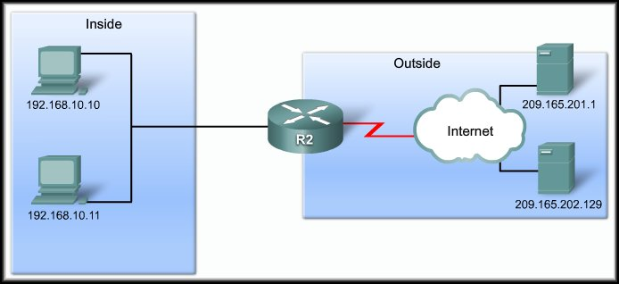
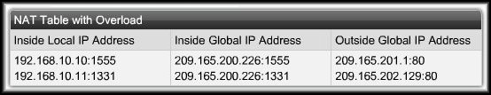
NAT Overload
Port Address Translation (PAT):
209.165.200.226
SA | DA
192.168.10.10:1555 | 209.165.201.1:80
SA | DA
209.165.200.226:1555 | 209.165.201.1:80
SA | DA
209.165.200.226:1331 | 209.165.202.129:80
SA | DA
192.168.10.11:1331 | 209.165.202.129:80

Slide 54
NAT Overload
Port Address Translation (PAT):
209.165.200.226
SA | DA
209.165.201.1:80 | 209.165.200.226:1555
SA | DA
209.165.201.1:80 | 192.168.10.10:1555
SA | DA
209.165.202.129:80 | 192.168.10.11:1331
SA | DA
209.165.202.129:80 | 209.165.200.226:1331

Slide 55
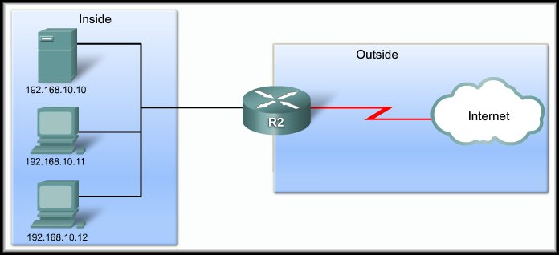

NAT Overload
Port Address Translation (PAT): NEXT AVAILABLE PORT
192.168.10.11:1444
192.168.10.12:1444

Slide 56
Benefits and Drawbacks
NAT Benefits:
  Conserves the legally registered addressing scheme.
  Increases the flexibility of connections to the public network.
  Provides consistency for internal network addressing schemes.
  Provides network security.

Slide 57
Benefits and Drawbacks
NAT Drawbacks:
  Performance is degraded.
  End-to-end functionality is degraded.
  End-to-end trace is lost.
  Tunneling is more complicated.
  Initiating TCP connections can be disrupted.
    TCP initiated from the outside or stateless protocols using UDP.
  Network architectures may have to be rebuilt.

Slide 58
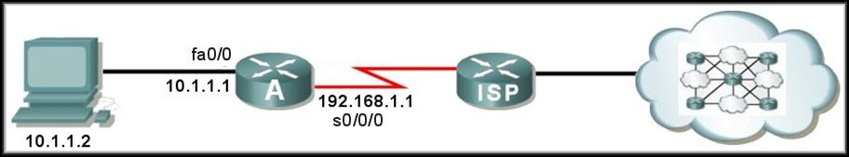

Configuring Static NAT
Step 1:
  Specify static translation between an inside local and inside global address.
  ip nat inside source static
  local-ip global-ip
179.23.2.2 – Inside Global address from ISP.
Port Address
ISP routing table:
179.23.2.0 via 192.168.1.1
RA(config)#ip nat inside source static 10.1.1.2 179.23.2.2

Slide 59
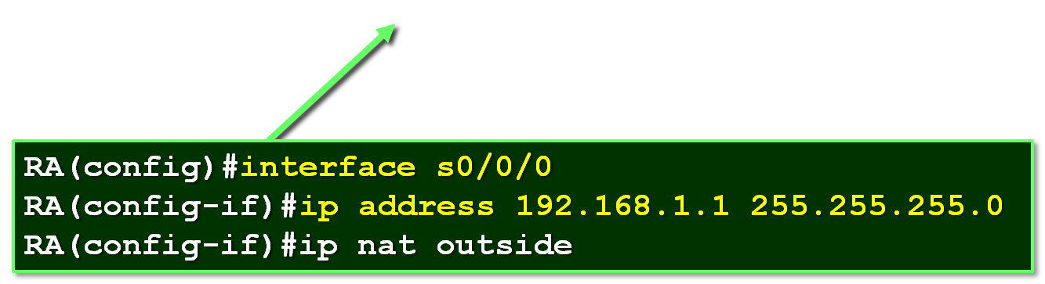
Configuring Static NAT
Step 2:
  Mark the router interfaces as an inside interface or an outside interface.
RA(config)#interface fa0/0
RA(config-if)#ip address 10.1.1.1 255.255.255.0
RA(config-if)#ip nat inside
ISP routing table:
179.23.2.0 via 192.168.1.1

Slide 60
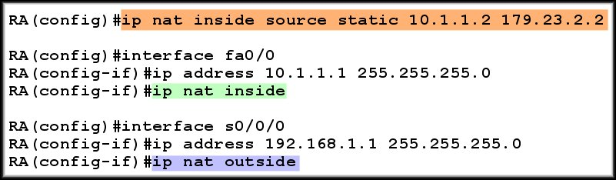
Configuring Static NAT
Summary:
10.1.1.2 will always translate to 179.23.2.2

Slide 61
Configuring Dynamic NAT
  Define a named address pool of outside addresses to be used for translation.
  Define an access list to specify those inside addresses that are eligible for translation.
  Specify dynamic translation between the
  inside addresses allowed by the access list
  and the
  pool of outside addresses.
  Mark the interfaces as inside or outside.

Slide 62
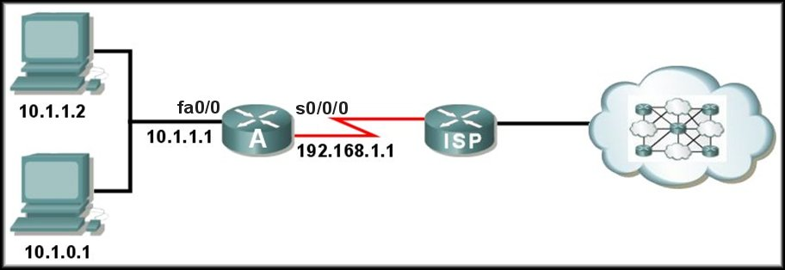
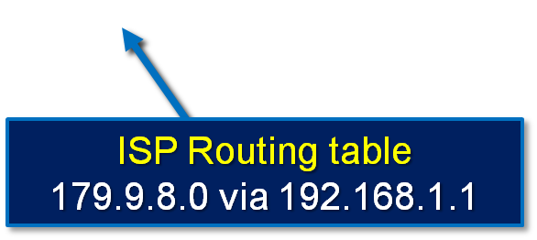
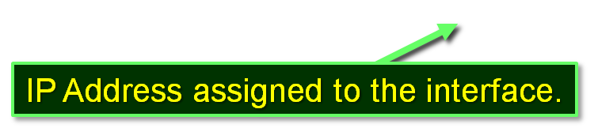
Configuring Dynamic NAT
Step 1:
  Define a named address pool of outside addresses to be used for translation.
  ip nat pool name start-ip end-ip
  (netmask netmask |
  prefix-length prefix-length)
Address space from ISP = 179.9.8.0/24

Slide 63
Configuring Dynamic NAT
Step 1:
  Define a named address pool of outside addresses to be used for translation.
  ip nat pool NAT-POOL1 179.9.8.80 179.9.8.85
  netmask 255.255.255.0
Range
Name
Mask
Address space from ISP = 179.9.8.0/24

Slide 64
Configuring Dynamic NAT
Step 2:
  Define an access list to specify those inside addresses that are eligible for translation.
  access-list access-list-number
  permit source [source wildcard]
Address space from ISP = 179.9.8.0/24

Slide 65
Configuring Dynamic NAT
Step 2:
  Define an access list to specify those inside addresses that are eligible for translation.
  access-list 1 permit 10.1.0.0 0.0.255.255
Allows ALL inside network addresses to be translated.
Address space from ISP = 179.9.8.0/24

Slide 66
Configuring Dynamic NAT
Step 2:
  Specify dynamic translation between the inside addresses allowed by the access list and the
  pool of outside addresses.
  ip nat inside source list access-list-number
  pool pool-name
Address space from ISP = 179.9.8.0/24

Slide 67
Configuring Dynamic NAT
Step 3:
  Specify dynamic translation between the inside addresses allowed by the access list and the
  pool of outside addresses.
  ip nat inside source list 1 pool NAT-POOL1
From Step 1
From Step 2
Address space from ISP = 179.9.8.0/24

Slide 68
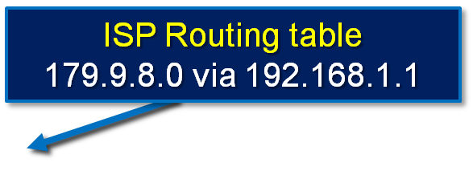
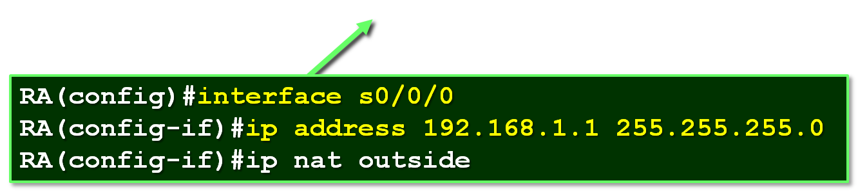
Configuring Dynamic NAT
Step 4:
  Mark the interfaces as inside or outside.
RA(config)#interface fa0/0
RA(config-if)#ip address 10.1.1.1 255.255.255.0
RA(config-if)#ip nat inside

Slide 69
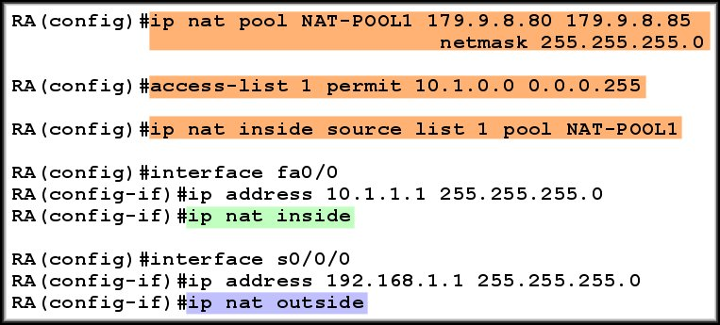
Configuring Dynamic NAT
All inside hosts are eligible for NAT.
Summary:

Slide 70
Configuring NAT Overload (PAT)
There are two possible ways to configure overloading.
  It depends on how the ISP allocates public IP addresses.
    The ISP allocates one public IP address to the organization.
    The ISP allocates more than one public IP address.
    In either case, the configuration will include the overload keyword.
      This keyword specifies to the router that Port Address Translation (PAT) is to be used.

Slide 71
Configuring NAT Overload (PAT)
The ISP allocates one public IP address to the organization.
  Assign the IP address received from the ISP as the IP address of the outside interface.
  Define a standard access list permitting those addresses to be translated.
  Establish dynamic translation specifying the access list and the actual interface instead of a pool of addresses and include the overload keyword.
  Identify the inside and outside interfaces.

Slide 72
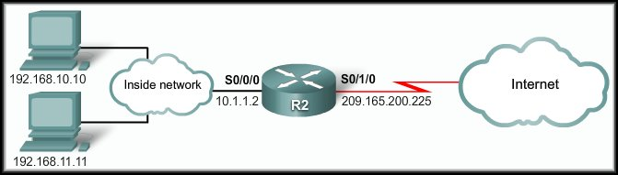
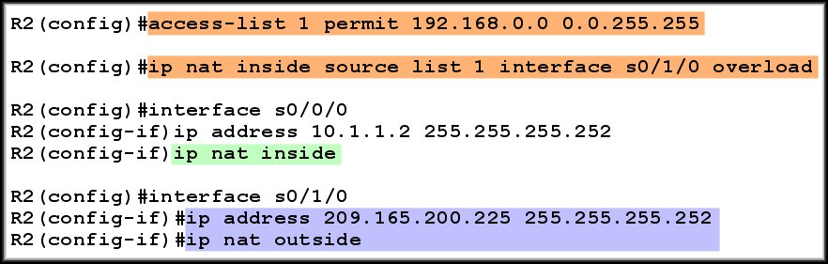
Configuring NAT Overload (PAT)
The ISP allocates one public IP address to the organization.
Assigned by ISP

Slide 73
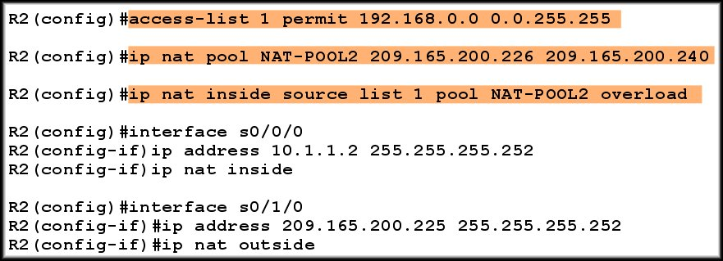
Configuring NAT Overload (PAT)
The ISP allocates more than one public IP address.

Slide 74
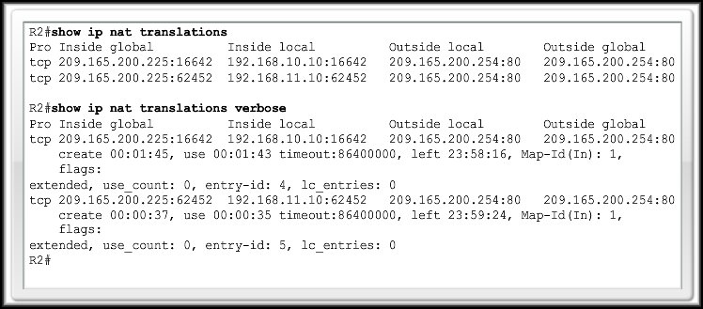
Verifying NAT and NAT Overload
show ip nat translations

Slide 75
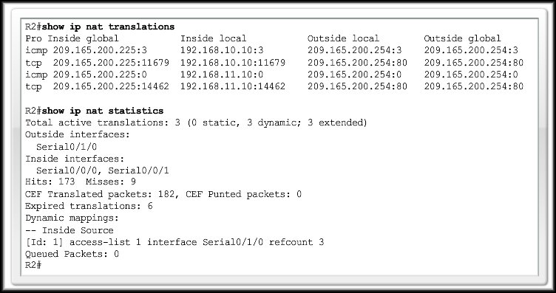
Verifying NAT and NAT Overload
show ip nat statistics

Slide 76
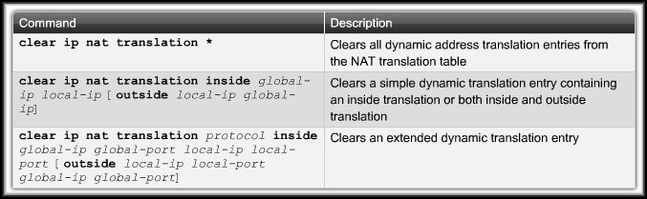
Verifying NAT and NAT Overload
clear ip nat translation

Slide 77
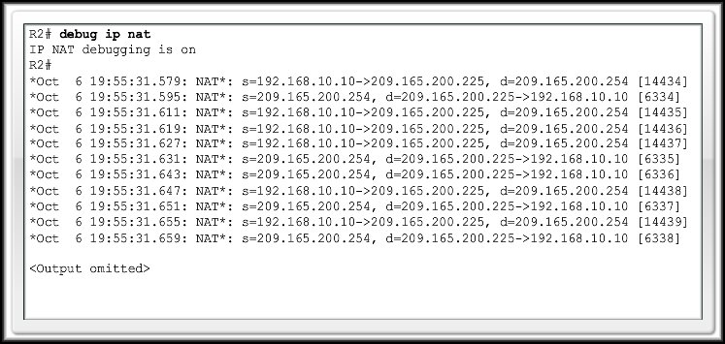
Troubleshooting NAT and NAT Overload
show ip nat translations
clear ip nat translation
debug ip nat

